Slide 1


Slide 2
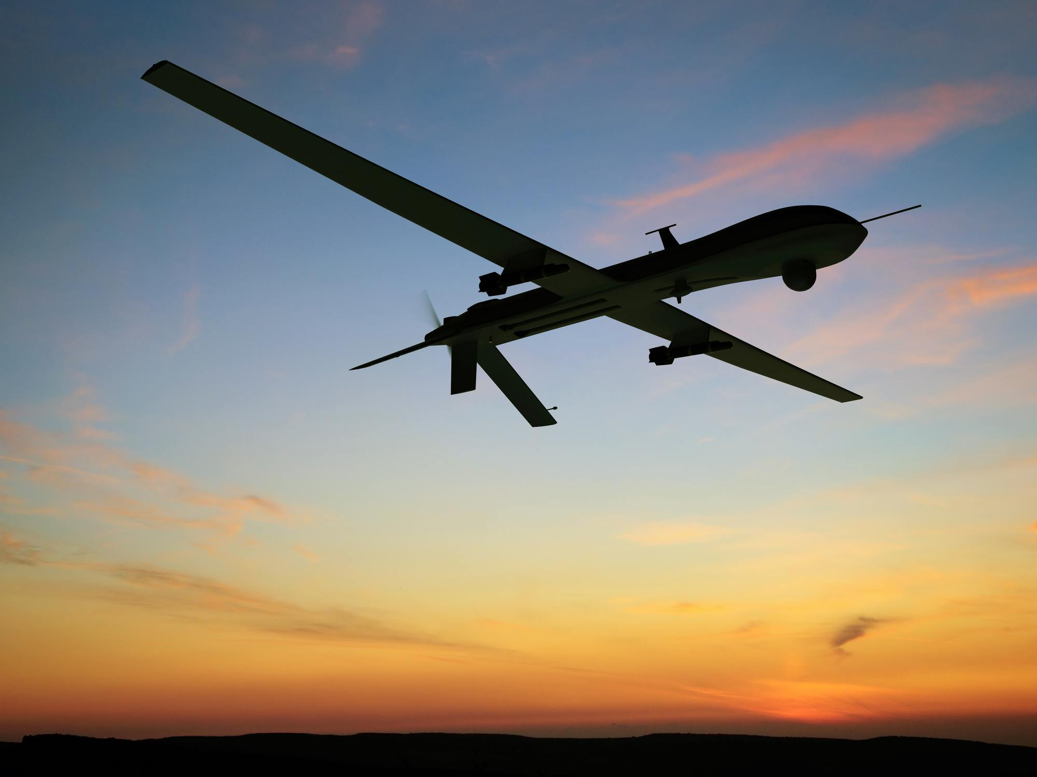
DRONE IN DEFENCE
OUR TEAM
*Priyanka
*Vinayak
*Abhishek
*Samarth
*Joel

Slide 3
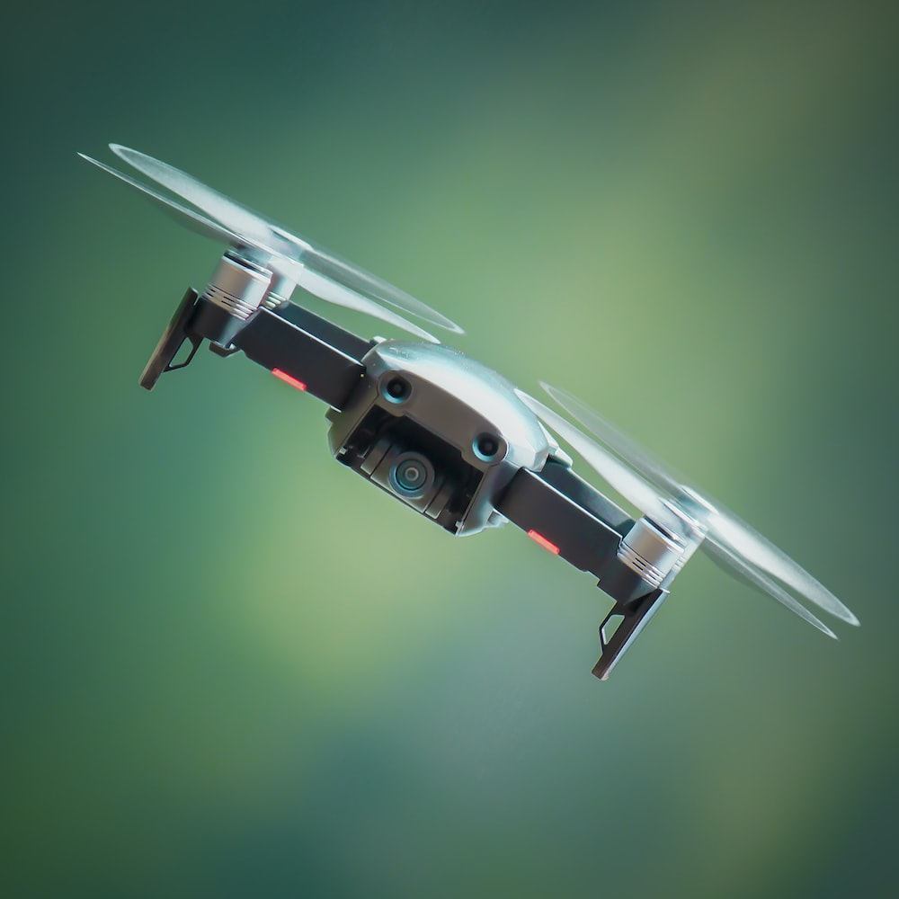
1. Plastic
Plastic is easy to mold into solid objects of different sizes and shapes. Lighter than metal alloys, plastic has high malleable properties and offers high resistance to corrosion and chemicals. I
2. Aluminum Alloys
Aluminum is a common metal used to construct drone airframes.
3. Composites
Compared to aluminum, composites reduce weight by 15-45%. Besides high strength, composites are resistant to corrosion from saltwater and electrolysis.
1. Plastic
Plastic is easy to mold into solid objects of different sizes and shapes. Lighter than metal alloys, plastic has high malleable properties and offers high resistance to corrosion and chemicals. I
2. Aluminum Alloys
Aluminum is a common metal used to construct drone airframes.
3. Composites
Compared to aluminum, composites reduce weight by 15-45%. Besides high strength, composites are resistant to corrosion from saltwater and electrolysis.
1. Plastic
Plastic is easy to mold into solid objects of different sizes and shapes. Lighter than metal alloys, plastic has high malleable properties and offers high resistance to corrosion and chemicals. I
2. Aluminum Alloys
Aluminum is a common metal used to construct drone airframes.
3. Composites
Compared to aluminum, composites reduce weight by 15-45%. Besides high strength, composites are resistant to corrosion from saltwater and electrolysis.

Slide 4
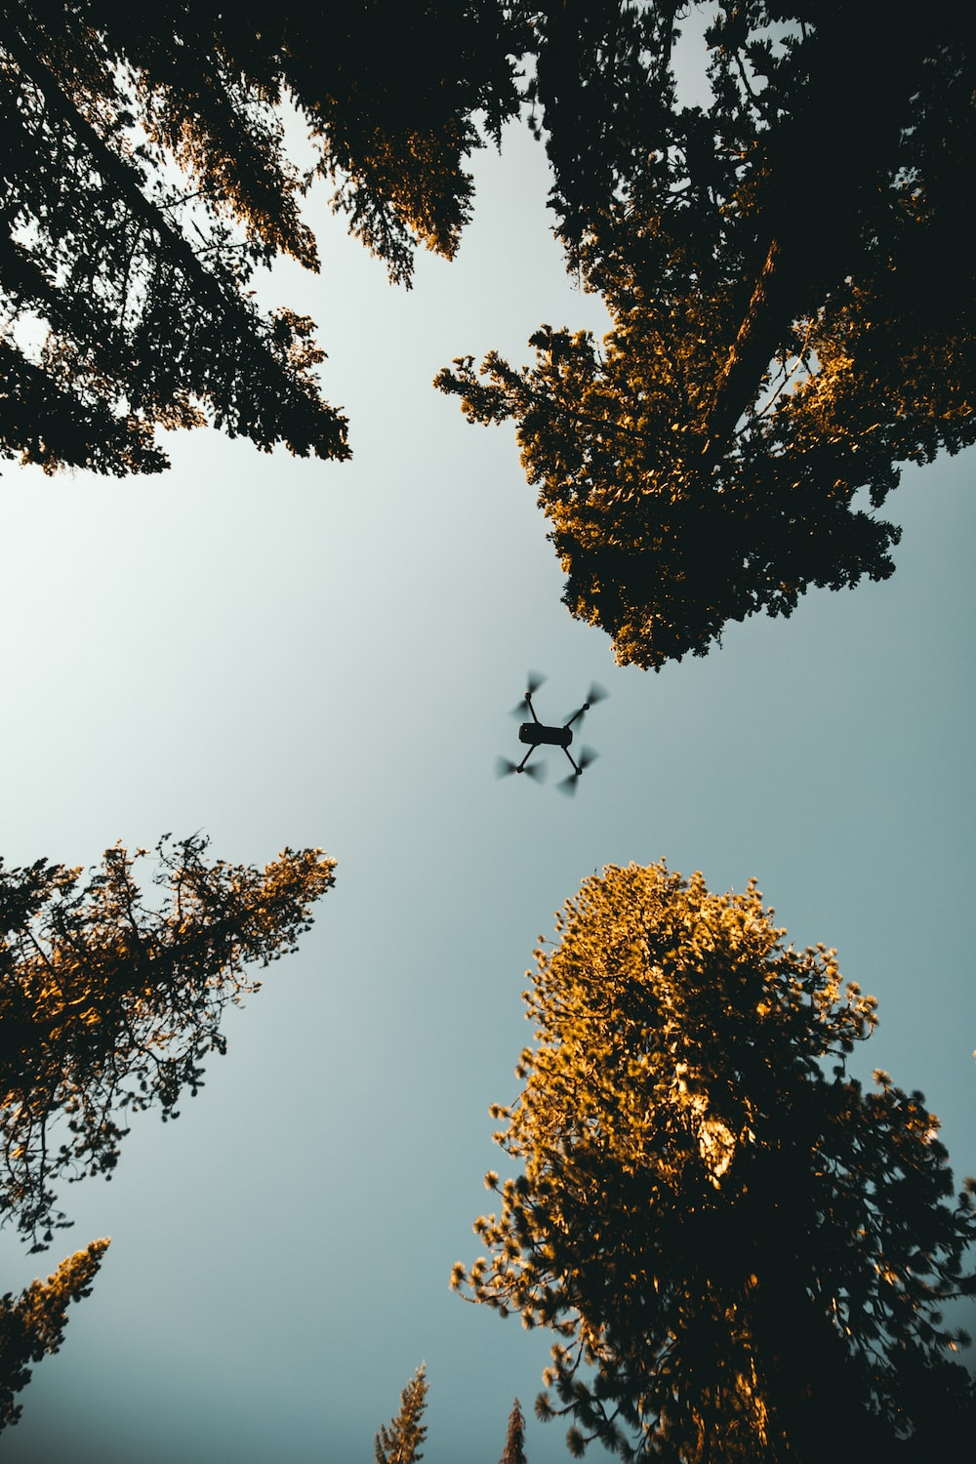
Power supplies :
There are different power sources for a drone, including battery, solar, hydro fuel cell, combustion engine, cable-tethered power supply and laser beam power. The most common source of power is a lithium-polymer battery.

Slide 5
Actuators and motors :
These include digital electronic speed controllers linked to engines, propellers, servomotors and others.
Sensors
Various sensors are used in a drone as per requirement and application. Position and movement sensors give information about the state of the aircraft. Common sensors are laser, radar, camera, gyroscope, accelerometer, compass, barometer and GPS receiver.
Computing
Drones use advanced computing technology, from analogue controls to microcontrollers, systems-on-chip and single-board computers.
Software

Slide 6
Software :
Flight stack or autopilot software are used in drone applications. Open source software like Openpilot and others are easily available.
Also, there are many smartphone apps available for drones.
Remote control :
Most drones use radio frequency to communicate between the remote and the drone, which may be capable of autonomous or semi-autonomous operations. Remote control signals from the operator side can be issued from one of the following:

Slide 7
Ground control, which is a human operating a radio transmitter, smartphone, computer or other similar control system.
Remote network system, like satellite duplex data links, cellular mesh and LTE network.
Another aircraft serving as a relay or mobile control station.

